Slide 1

Wellbeing CHAMPION training
Craig Aldridge (She/they)
Craig.Aldridge@surrey.ac.uk
Student Support Coordinator Surrey Students Union

Slide 2
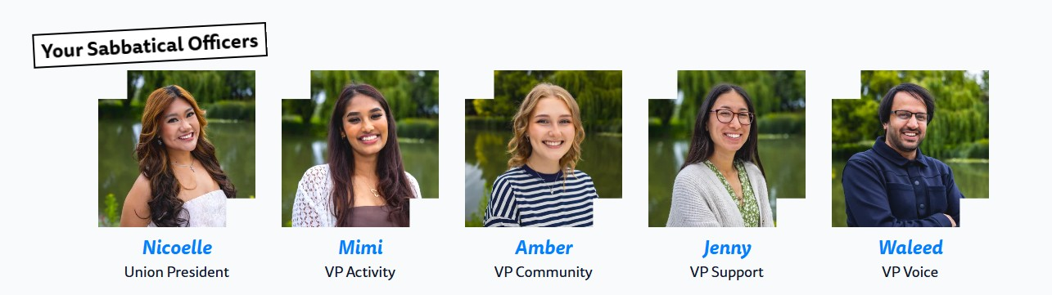
Introductions
Sabbatical Officers, Union Zones & Campus Safety

Slide 3

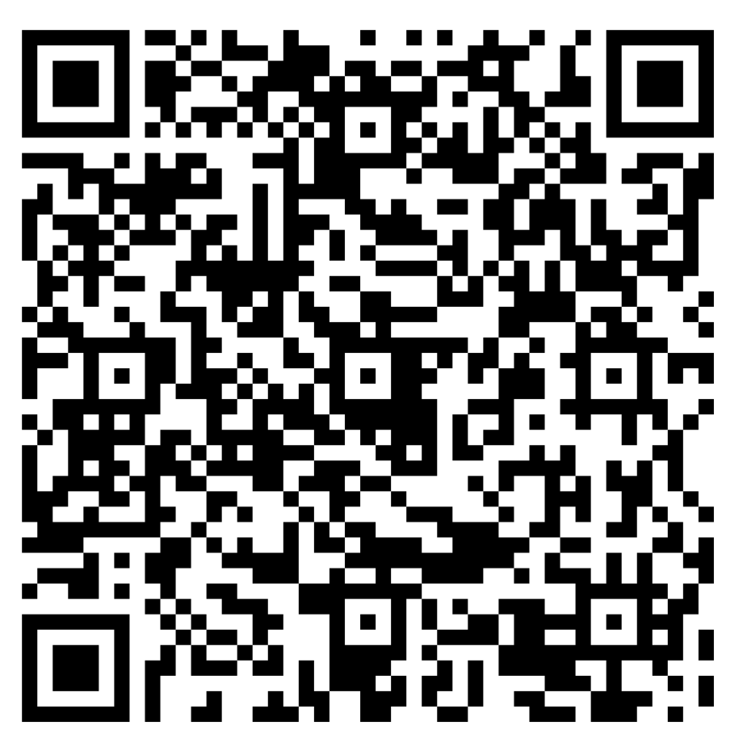
surreyunion.org
Your Surrey Life.

Slide 4
Campus Safety

Slide 5

Campus Safety
We Provide:
First line response to crime, fire, medical, MH issues or any other incidents.
24/7 staffed Control Room and out of hours reception.
24/7 patrols of campuses
OOH pastoral care

Slide 6
Campus Safety
Going Out?
Guildford is a LOW crime area – NOT a NO crime area.
Learn your way around.
Stick with friends.
Seek help if you need it.
Get a free personal safety alarm from Campus Safety and carry it with you and make sure it's easily accessible
Always keep hold of your drinks and use an anti-drink spiking device
At night keep to well-lit streets and walk with others
We have street marshals to help keep you safe off campus
Use a safety app. (Hollie guard)

Slide 7
Campus Safety
Campus Safety:
01483 68(2002) for advice and general assistance
01483 68(3333) in an emergency
Useful numbers:
NHS 111
Police 101
SAMARITANS 116 123
CRISIS TEAM 0300 4568342
SAFE HAVEN 01483 303649 18.00-23.00

Slide 8
Introduction to your role
What do you do
and
what can you get out of it?

Slide 9
Recognition
&
C.V Boosts
C.V Boosts:
Active listening
Bystander Intervention
Mental Health Awareness & Disclosures
Conflict Resolution
Event & Project Planning
Diversity & Inclusion
Signposting
Problem Solving
& More
Qualifications are important but ‘soft skills’ and diverse experience make you stand out
surreyunion.org
Your Surrey Life.

Slide 10
The Roles of Wellbeing Champions
What are your roles?
Be a known face within your club / society.
Be available to members to come to talk to.
Be knowledgeable about support available.
Be proactive in supporting members and engaging them in you club / society.
Be in contact with the SU about issues & opportunities.
surreyunion.org
Your Surrey Life.

Slide 11
The Roles of Wellbeing Champions
BUILD
THE
GOAL
surreyunion.org
Your Surrey Life.

Slide 12
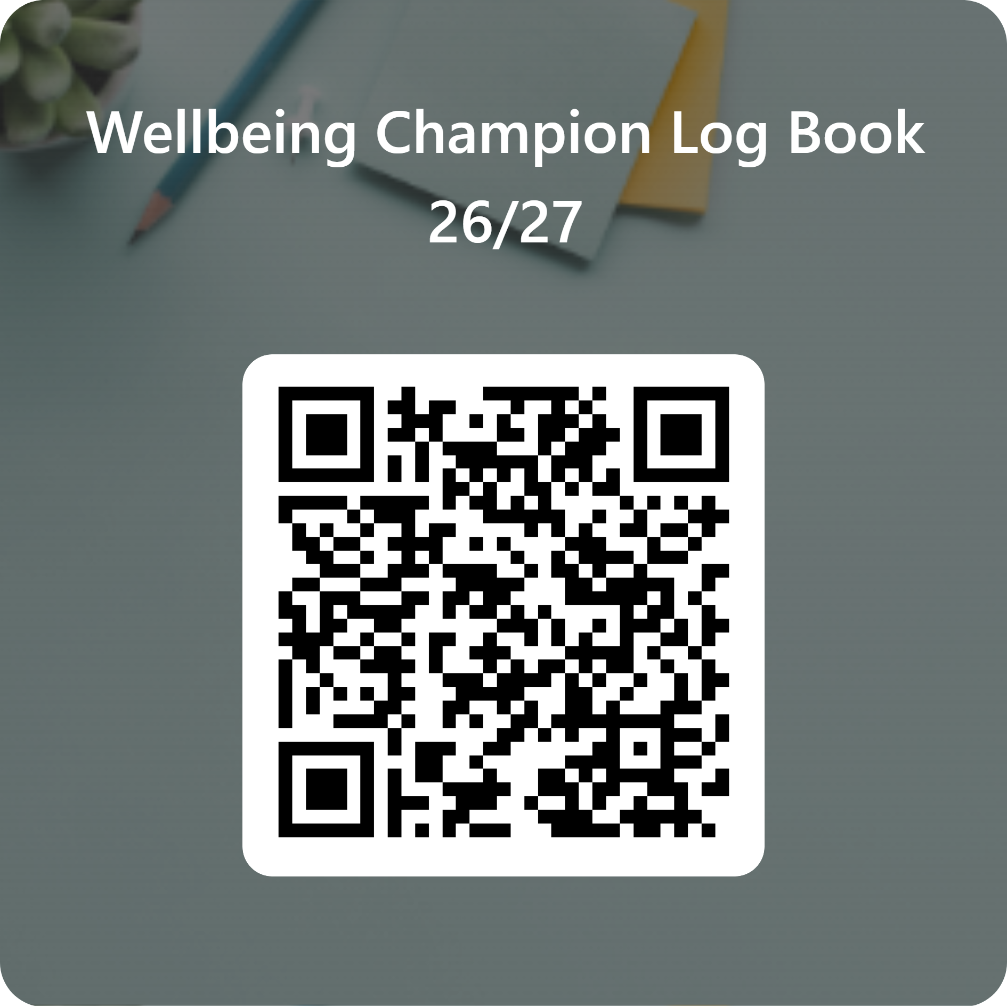
surreyunion.org
Your Surrey Life.

Slide 13
Wellbeing Champions Webpage
surreyunion.org
Your Surrey Life.

Slide 14
Setting boundaries

Slide 15
What are boundaries?
1. What is a boundary and why
2. What boundaries do we already have
3. How we state them
4. Examples
5.. Think of club / society specific boundaries
surreyunion.org
Your Surrey Life.

Slide 16

Fun
Surprisingly glamourous
Supportive
Optimistic

Slide 17
What are boundaries?
The limits defining you in relationship to someone or to something
surreyunion.org
Your Surrey Life.

Slide 18
What are boundaries?
Why boundaries first?
surreyunion.org
Your Surrey Life.

Slide 19
Fun
Surprisingly glamourous
Supportive
Optimistic
surreyunion.org
Your Surrey Life.

Slide 20
Talked down to
Fun
Surprisingly glamourous
Hassling me
Supportive
Situations that
Upset/trigger me
Optimistic
Desperation
surreyunion.org
Your Surrey Life.

Slide 21
Chose Patience
Talked down to
Fun
Surprisingly glamourous
Set reply times
& volume
Hassling me
Supportive
Avoid certain topics
Situations that
Upset/trigger me
Optimistic
Desperation
Stay Humble
surreyunion.org
surreyunion.org
Your Surrey Life.

Slide 22
Examples of boundaries you can set as a WBC:
1. No is always ok
2. Have set hours
3. Have set platforms / accounts
4. Avoid your triggers
5. Signposting
surreyunion.org
Your Surrey Life.

Slide 23
How to express your boundaries:
Officially
Clearly
Repeatedly
surreyunion.org
Your Surrey Life.

Slide 24
Boundary breaches:
It is inevitable that boundaries can and will be breached.
DO NOT FEEL GUILTY WHEN SOMEONE BREACHES YOUR BOUNDARY and YOU SAY NO.
Its OKAY to signpost people elsewhere.
The Union and University Support Services are here to support you.
surreyunion.org
Your Surrey Life.

Slide 25
Understanding yourself is how to set Boundaries
surreyunion.org
Your Surrey Life.

Slide 26

Signposting guide
Guide of available support services & projects,
Run by the Union, University and local area.
surreyunion.org
Your Surrey Life.

Slide 27
In conclusion (Boundaries)
“A boundary is a limit or space between you and the other person; a clear place where you begin, and the other person ends . . . The purpose of setting a healthy boundary is, of course, to protect and take good care of you”
surreyunion.org
Your Surrey Life.

Slide 28
Engaging withConflict

Slide 29
How might you encounter conflict as a Wellbeing Champion?
surreyunion.org
Your Surrey Life.
Notes:
Split into groups around you and write on paper how you might encounter conflict.
(volunteer up front have all speak at them and then try to resolve by CALM)

Slide 30
How to actively engage with conflict:
surreyunion.org
Your Surrey Life.

Slide 31
How to actively engage with conflict:
C
A
L
M
surreyunion.org
Your Surrey Life.

Slide 32
How to actively engage with conflict:
Compromise
Avoid blame
Listen
Move forward
surreyunion.org
Your Surrey Life.

Slide 33


surreyunion.org
Your Surrey Life.

Slide 34
How to actively engage with conflict:
Committee Drama
2 of your SIGs are best mates and live together, the other is feeling left out and excluded from decisions as they are being discussed at their home.
1 of your committee isn’t completing their duties in time and an important club event didn’t happen as a result, everyone else is mad.
Compromise
Avoid blame
Listen
Move forward
Your committee are arguing over who should be doing what. Each thinking that they are responsible for something another feels is they’re job.
surreyunion.org
Your Surrey Life.

Slide 35
Not responsible
Not a target
Not alone
surreyunion.org
Your Surrey Life.

Slide 36
Any questions?
surreyunion.org
Your Surrey Life.

Slide 37
Mental health awareness and Disclosures

Slide 38
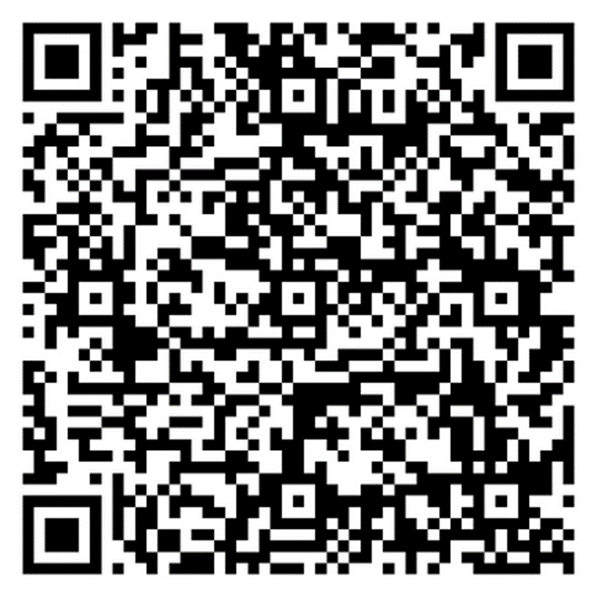
Report a Wellbeing Concern
surreyunion.org
Your Surrey Life.

Slide 39
Mental Health
Providing Psychological Safety
Outlining your role can also promote psychological safety (this means generating a feeling of support).
Saying what you can and can’t do will help the individual manage their disclosure.
surreyunion.org
Your Surrey Life.

Slide 40
Mental Health Matters
You might be the first person someone opens up to about their mental health.
A privilege not a problem.
surreyunion.org
Your Surrey Life.

Slide 41
Mental Health, An Introduction
We all struggle sometimes.
Whether it’s stress, overwhelmed, or just feeling off, mental health challenges are part of being human.
Pressure, uncertainty, and unrealistic expectations. It’s a lot.
That’s why it takes real strength to say, “I’m not okay.”
Don’t underestimate how powerful and helpful listening is.
surreyunion.org
Your Surrey Life.
Notes:
Story of guy who was fine and strong but having a breakdown

Slide 42
What is Mental Health?
When you think of mental health, what comes to mind for you?
1 Minute –
How many Mental Health Myths or stereotypes or stigmas can you think of?
surreyunion.org
Your Surrey Life.

Slide 43
What is Mental Health?
Mental health myths
It’s a weakness
It’s not visible, so not a problem
Weirdo / dangerous
Mental health medication makes someone like a zombie
Everyone on social media claims to have mental health issues, but it’s just attention seeking
It is shameful to admit
surreyunion.org
Your Surrey Life.

Slide 44
Mental Health
As a Wellbeing Champion remember to outline that this discussion is confidential; however, this is never absolute.
Confidentially cannot be maintained if:
They are putting themselves at extreme risk.
They are putting others at extreme risk (particularly a child).
They are planning a terrorist act.
surreyunion.org
Your Surrey Life.

Slide 45

Mental Health – A Deeper Dive
Mental health is an equaliser – it can affect anyone, regardless or status, at anytime in their life.
The
university
journey
surreyunion.org
Your Surrey Life.
Notes:
Split room in 3 arriving and First year, Middle Years, Final and transition out

Slide 46
Mental Health – A Deeper Dive
Major Life Transition: Leaving home and familiar environments can cause stress and uncertainty.
Loss of Support Networks: Separation from family, friends, and established support systems may lead to feelings of isolation.
Academic Pressure: High expectations, workload, and fear of failure can contribute to anxiety and stress.
Social Challenges: Pressure to form new friendships and fit in can cause social anxiety or loneliness.
Identity Development: University is a key time for exploring identity, which can be confusing or emotionally taxing.
surreyunion.org
Your Surrey Life.

Slide 47
Mental Health – A Deeper Dive
Financial Stress: Managing money, student loans, or part-time jobs.
Increased Independence: Time management, self-care can be overwhelming.
Exposure to Risk Behaviours: New freedom may lead to experimentation with alcohol, drugs, or unhealthy coping mechanisms.
Pre-existing Conditions: Mental health issues may worsen without the continuity of previous care, or family reminders to take medication.
Uncertainty About the Future: Concerns about career paths and post-university life can contribute to anxiety.
surreyunion.org
Your Surrey Life.

Slide 48

Mental Health – A Deeper Dive
surreyunion.org
Your Surrey Life.

Slide 49
Mental Health – A Deeper Dive
25 on October 10th World Mental Health Day
surreyunion.org
Your Surrey Life.

Slide 50
Mental Health – A Deeper Dive
Up to about age 25 is a time of big change, with hormonal fluctuations, the brain is still developing, and emotional sensitivity is more acute.
Therefore, it is no surprise that students need support at some point.
surreyunion.org
Your Surrey Life.

Slide 51
Mental Health – A Deeper Dive
Student Minds - MH Continuum Video
surreyunion.org
Your Surrey Life.

Slide 52
Mental Health – A Deeper Dive
Try to remember that mental health and wellbeing is dynamic,
it is ever changing because life is ever changing.
Dynamic factors include
Life events – bereavements, relationship breakdown, moving home
Stress levels – deadlines, changes to friendship groups
Environmental – Noisy neighbours, untidy or unclean home
Substance misuse – drugs, alcohol
surreyunion.org
Your Surrey Life.

Slide 53
Mental Health – A Deeper Dive
Mental health can also be static, attributed to factors that are unchanging.
Static factors include
Family History– there are links to generational mental health patterns
Adverse childhood experiences – childhood trauma can impact the development of neuropathways in the brain
Long term medical conditions – born with a life limiting illness
surreyunion.org
Your Surrey Life.

Slide 54
Common Mental Health Concerns
What is the most common mental health concern?
Hands up if you think it’s –
Depression/low mood
Anxiety
OCD
Bipolar Disorder
Disordered eating
PTSD
Source - NHS Digital (2022). Mental Health of Children and Young People in England, 2022 – wave 3 follow up to the 2017 survey.
A new era for young people’s mental health: COVID-19 impact survey.
https://www.youngminds.org.uk
surreyunion.org
Your Surrey Life.

Slide 55
Common Mental Health Concerns
The most commonly presented mental health concern is -
Anxiety – this includes generalised anxiety disorder, social anxiety, phobias.
Followed by
Depression – this includes persistent and/or prolonged low mood, major depressive episode
surreyunion.org
Your Surrey Life.

Slide 56
Anxiety
Anxiety is persistent, excessive fear or worry that interferes with daily life and functioning.
Cognitive | Emotional | Physical | Behavioural
Excessive worry | Nervousness | Headaches, stomach aches | Avoidance (e.g. lectures, social events)
Difficulty concentrating | Irritability | Muscle tension, restlessness | Reassurance seeking
Catastrophic thinking | Low self-esteem | Sleep problems | Perfectionism, compulsive habits
surreyunion.org
Your Surrey Life.

Slide 57
Depression/Low Mood
Depression/low mood is a persistent low mood and loss of interest or pleasure, affecting thoughts, emotions, and functioning.
Cognitive | Emotional | Physical | Behavioural
Negative self-talk / hopelessness | Sadness or emptiness | Fatigue / low energy | Withdrawal from friends or activities
‘Can’t be bothered’ | Irritability or anger | Changes in appetite, frequently ill – catching a cold regularly | Isolating self / academic decline
Difficulty making decisions | Feeling worthless or guilty | Sleep disturbances | Self-harm or risk-taking behaviours
surreyunion.org
Your Surrey Life.

Slide 58
You Mentioned Others…
OCD is related to anxiety, gently recommend the Centre for Wellbeing.
Bipolar is a psychiatric issues and needs specific support, the Centre for Wellbeing can support the student to access the correct service.
Disordered eating can be complex, firstly, recommend the Centre for Wellbeing.
PTSD can be very distressing and needs careful consideration, let them know the Centre for Wellbeing can help.
surreyunion.org
Your Surrey Life.

Slide 59
What is Self-Harm
Deliberate injury to one’s own body as a way to manage overwhelming emotional distress. It is not always linked to suicidal intent, but it is a significant risk factor.
Cognitive | Emotional | Physical | Behavioural
Intense self-criticism | Emotional numbness or overload | Cuts, burns, or bruises | Hiding injuries (e.g. long sleeves)
Intrusive negative thoughts | Shame, guilt, anger | Lack of care for the body | Avoidance of certain activities that might show fresh self-harming.
Thoughts of being a burden | Feeling out of control | Scars in various stages of healing | Secretive use of sharp objects or tools
surreyunion.org
Your Surrey Life.

Slide 60
Response to Self-Harm
✅ DO: | 🚫 DON’T:
- Listen calmly and kindly | - Don’t promise to keep it a secret
“Thanks for trusting me — I’m here for you.” | - Don’t judge, or try to fix them
- Encourage them to talk to their support network | - Don’t joke about it or compare struggles
- Stay connected — let them know you care | - Don’t ignore it — they’ve reached out for a reason
- Recommend the Centre for Wellbeing
- Safety comes first, make sure they have attended to the injury.
Remember:
You don’t have to solve it. Just be kind, stay calm, and speak up.
surreyunion.org
Your Surrey Life.

Slide 61
Lets talk about Suicide
If you need to leave that is ok.
surreyunion.org
Your Surrey Life.

Slide 62
Why Someone Might Feel Suicidal
Overwhelming emotional pain or hopelessness
Feeling like a burden or that others would be “better off”
Disturbing memories that they feel unable to manage
Mental health conditions (e.g. depression, PTSD, anxiety)
Feeling trapped, isolated, or unable to cope
Sudden, unexpected changes to life that feel out of control or don’t know how to manage.
surreyunion.org
Your Surrey Life.

Slide 63
What To Listen Out For
‘Everyone would be better off without me’
‘I can’t do this anymore’
‘I just want it all to stop’
Talking about death or disappearing
surreyunion.org
Your Surrey Life.

Slide 64
How would you feel?
Talk to those around you.
surreyunion.org
Your Surrey Life.

Slide 65
Let’s Talk About Suicide….
What to do if a student tells you they are feeling suicidal
DO:
Listen carefully and calmly
I’m really glad you told me. There is plenty of support
Encourage them to use their support network
Refer to the Centre for Wellbeing, if urgent, they need to go to A&E. Campus safety can call an ambulance
Find out if a friend or someone can stay with them for awhile.
Fill in the WBC logbook
surreyunion.org
Your Surrey Life.

Slide 66
Let’s Talk About Suicide….
What to do if a student tells you they are feeling suicidal
DON’T:
- Don’t promise to keep it a secret
- Don’t ignore or dismiss their feelings
- Don’t try to handle it all by yourself, get professional help for them
- Don’t judge, criticise, or react with panic
DON’T:
- Don’t promise to keep it a secret
Remember:
You don’t have to fix their pain. Just be present, listen (and refer to the Centre for Wellbeing)
surreyunion.org
Your Surrey Life.

Slide 67
Talking is Good
Talking about suicide saves lives.
Opening up about suicidal thoughts doesn't make things worse - it helps.
When someone talks about how they're feeling, it's not dangerous - it's courageous.
Talking is often the first step toward feeling better.
With the right support, professional help, and kindness, recovery is possible.
surreyunion.org
Your Surrey Life.

Slide 68
Risk Protocols
Are they at immediate risk of harm now?
Are they at immediate risk of harm to themselves if left alone?
Are they an immediate risk to someone else if left alone?
Call Campus Safety
01483 68(3333)
Call 999 (Stay with them, ideally with a third person)
If you are in any doubt call Campus Safety or 101 anyway
surreyunion.org
Your Surrey Life.

Slide 69
Risk Protocols
Is there risk of harm but is not immediate?
See if a friend can stay with them
Suggest going to the Centre for Wellbeing (Mon-Fri, 8am-5pm)
Provide resources for support – Safe Haven, Samaritans, etc.
surreyunion.org
Your Surrey Life.

Slide 70
You Matter!
Your self-care matters, therefore, it’s important you look after yourself.
Set boundaries, it’s okay to care without being someone’s only support.
Talk to someone you trust
Craig.Aldridge@surrey.ac.uk / WBC logbook
Centre for Wellbeing
Support services
surreyunion.org
Your Surrey Life.

Slide 71
Inappropriate
& Repeat disclosures

Slide 72
Inappropriate & repeat disclosures
Your priority as a WBC is to the whole club/society members and not just to this student. If it is impacting others, it is time to do something.
surreyunion.org
Your Surrey Life.

Slide 73
Do you feel like you can talk to them?
  In private (after a session?)
  Are the sessions the most appropriate space to be discussing their thoughts and feelings on X?
  Have they considered other support?
  Do you want to look at other support for them?
surreyunion.org
Your Surrey Life.

Slide 74
  “I am worried about you because…”
  “I am worried about the group because…”
surreyunion.org
Your Surrey Life.

Slide 75
If you DON’T feel like you can talk to them…
  That is ok.
  Come and talk to the Union and we can work out the best way forwards.
  Each situation is different and you might not feel right approaching it a certain way.
  Talk to us.
surreyunion.org
Your Surrey Life.

Slide 76
Break
Loo
Legs
Lunch
Late (Don’t be)

Slide 77
Radical Inclusion
EVERYONE.

Slide 78
The Roles of Wellbeing Champions
BUILD
THE
GOAL
surreyunion.org
Your Surrey Life.

Slide 79

Equality, Diversity & Inclusion
surreyunion.org
Your Surrey Life.

Slide 80
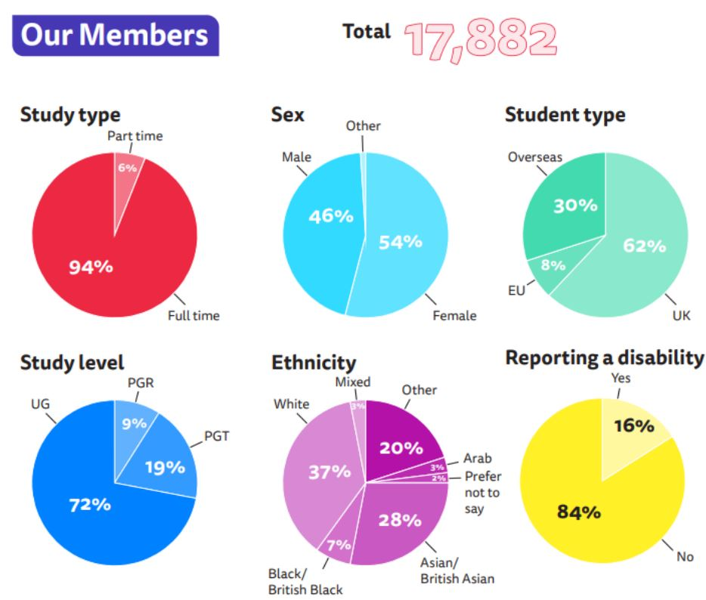
Demographics
16,277 (2024/25)
surreyunion.org
Your Surrey Life.

Slide 81
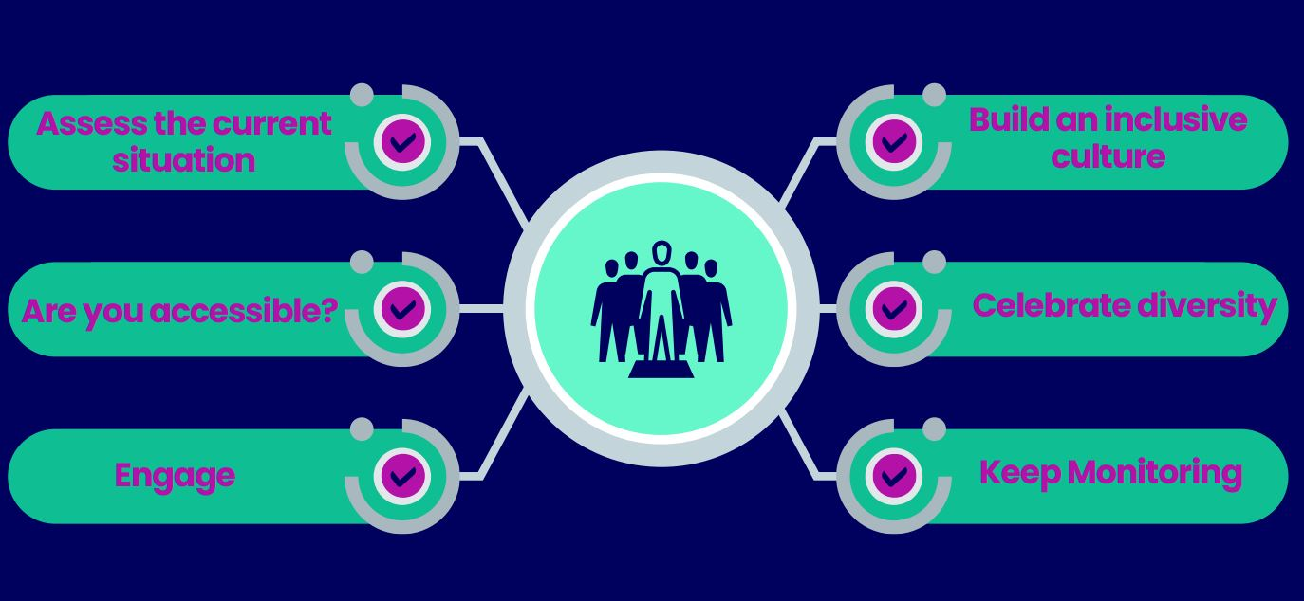
What can a Wellbeing Champion do?
surreyunion.org
Your Surrey Life.

Slide 82
Disability and Neuroinclusion
Wellbeing Champions
Created by Chris Steer
Head of Student Disability & Neuroinclusion Development

Slide 83
Disability & Neuroinclusion
Disability and Neuroinclusion (D&N), provides advice and support, arranging reasonable adjustments for any aspect of a student’s time at the University of Surrey including through the application process, including:
Putting in place reasonable adjustments (inc. studies, accommodation, parking, and placement considerations)
Implementing exam arrangements
Diagnosis referral advice
Providing advice on the Disabled Students’ Allowance
Providing 1:1 study skills and mentoring sessions
Signposting to internal and external departments/provision
Create Medical Information Forms and refer students for PEEPs

Slide 84
The Equality Act (2010)
You’re disabled under the Equality Act (2010) if you have a physical or mental impairment that has a ‘substantial’ and ‘long-term’ negative effect on your ability to do normal daily activities.
‘Substantial’ is more than minor or trivial, e.g. it takes much longer than it usually would to complete a daily task like getting dressed.
‘Long-term’ means 12 months or more, e.g. a breathing condition that develops as a result of a lung infection.
Definition of disability

Slide 85
The social model of disability
“The social model of disability is widely accepted as the most effective way that universities and colleges can respond to the needs of disabled students. The social model developed out of an understanding that disability is not something medical to be treated, but rather a failing on the part of society.”
Office for Students guidance
The social model of disability, SCOPE [video]

Slide 86
Creating an inclusive society (1)
Reduces the need to disclose
Removes barriers
Supports undiagnosed individuals and those awaiting diagnosis
Members feel valued, respected, and empowered
Fosters diversity which increases perspectives, reputation, and membership

Slide 87
Creating an inclusive society (2)
Accessible events, venues, and meetings
Easy-to-navigate and informative webpages
Inclusive communication
Responding to needs promptly and creatively
Collaboration with other clubs & societies, and departments
Inclusivity is everyone’s responsibility, but having one person BUILD THE GOAL can be more effective

Slide 88
Something easy to do
Look at your social posts / webpage.
Is it full of useful and detailed information?
Is it clean and concise, or is it wordy and busy?
Does it use inclusive language?
Is it accessible?
Does it make it clear how and who to contact?

Slide 89
Case study 1
Case study 2
Case study 3
A student who is a wheelchair user expresses an interest in joining your club or society.
What changes might you have to make to accommodate them?
What steps could you take now to anticipate students who are wheelchair users joining your society, and therefore make it more accessible and inclusive?
A blind student who relies on read-aloud assistive technology for all written communications joins your society.
What changes might you have to make to accommodate them, thinking about both the physical space, but also the way you communicate with your members?
Are there steps you could take now to improve your communication and make it more inclusive?
A long-term member of your society discloses anxiety to you and a difficulty with attending social events.
What steps could you take to support this student and plan social events that cater for all?
Can you identify particular barriers to joining your society, particularly thinking about those who may have anxiety?

Slide 90
Accessibility, inclusivity & diversity
Accessibility is removing barriers that prevent disabled people from being able to fully engage in all areas of life.
Inclusivity is creating events, societies, and clubs where everyone feels welcomed, respected, and a sense of belonging
Diversity is having a society where a wide range of differences including race, gender, sexuality, disability, and age, are present, valued, and respected.

Slide 91



surreyunion.org
Your Surrey Life.

Slide 92
surreyunion.org
Your Surrey Life.

Slide 93
Student Life
& Wellbeing

Slide 94



Campaigns and Services you can support
surreyunion.org
Your Surrey Life.

Slide 95

Campaigns and Services
Housing Fairs
‘SHAG’ Days
surreyunion.org
Your Surrey Life.

Slide 96
Campaigns and Services
Don’t
Worry
Surrey
Academic Support
Revision & Exam tips
Film Nights
Dog & Cat‘therapy’ sessions
Craft events
Sport Sessions
Wellbeing Week
October 26th – 30th
surreyunion.org
Your Surrey Life.

Slide 97
Campaigns and Services
Student Support Appointments
surreyunion.org
Your Surrey Life.
Notes:
The most important thing you can help your friends know – is that if they are struggling with university life issue they are not alone!

Slide 98
Campaigns and Services
PGR HUB
surreyunion.org
Your Surrey Life.

Slide 99
Building community
surreyunion.org
Your Surrey Life.

Slide 100
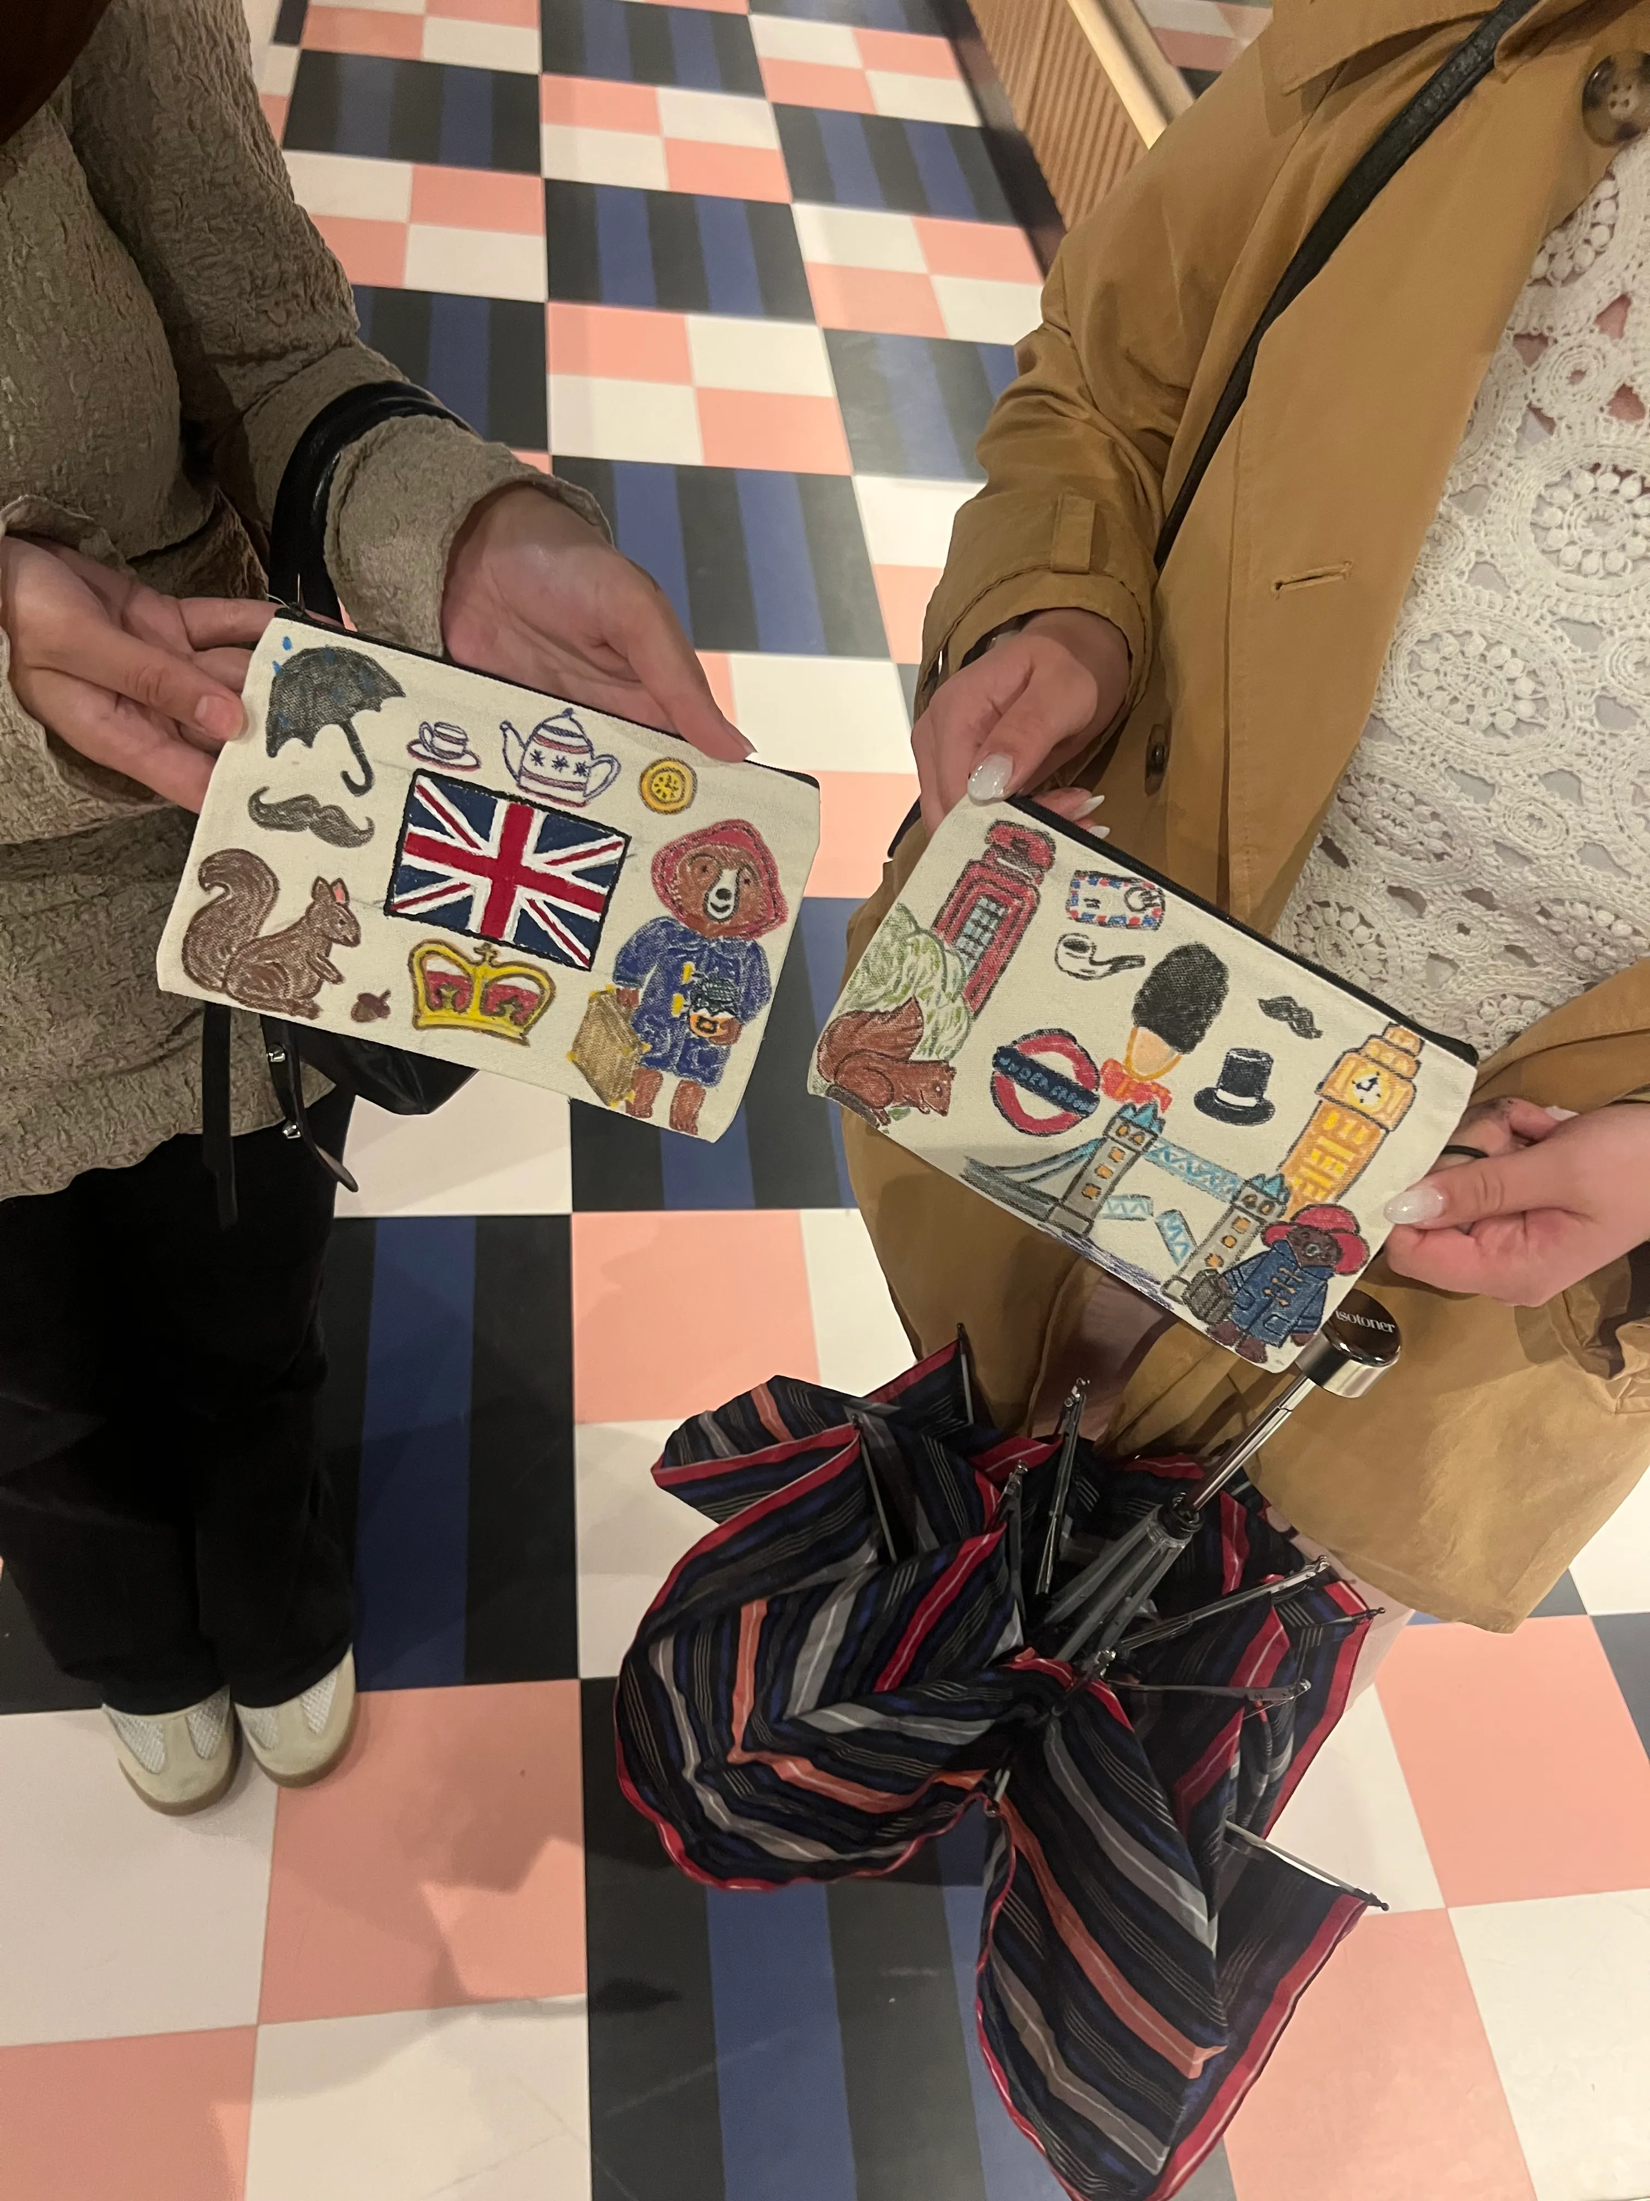
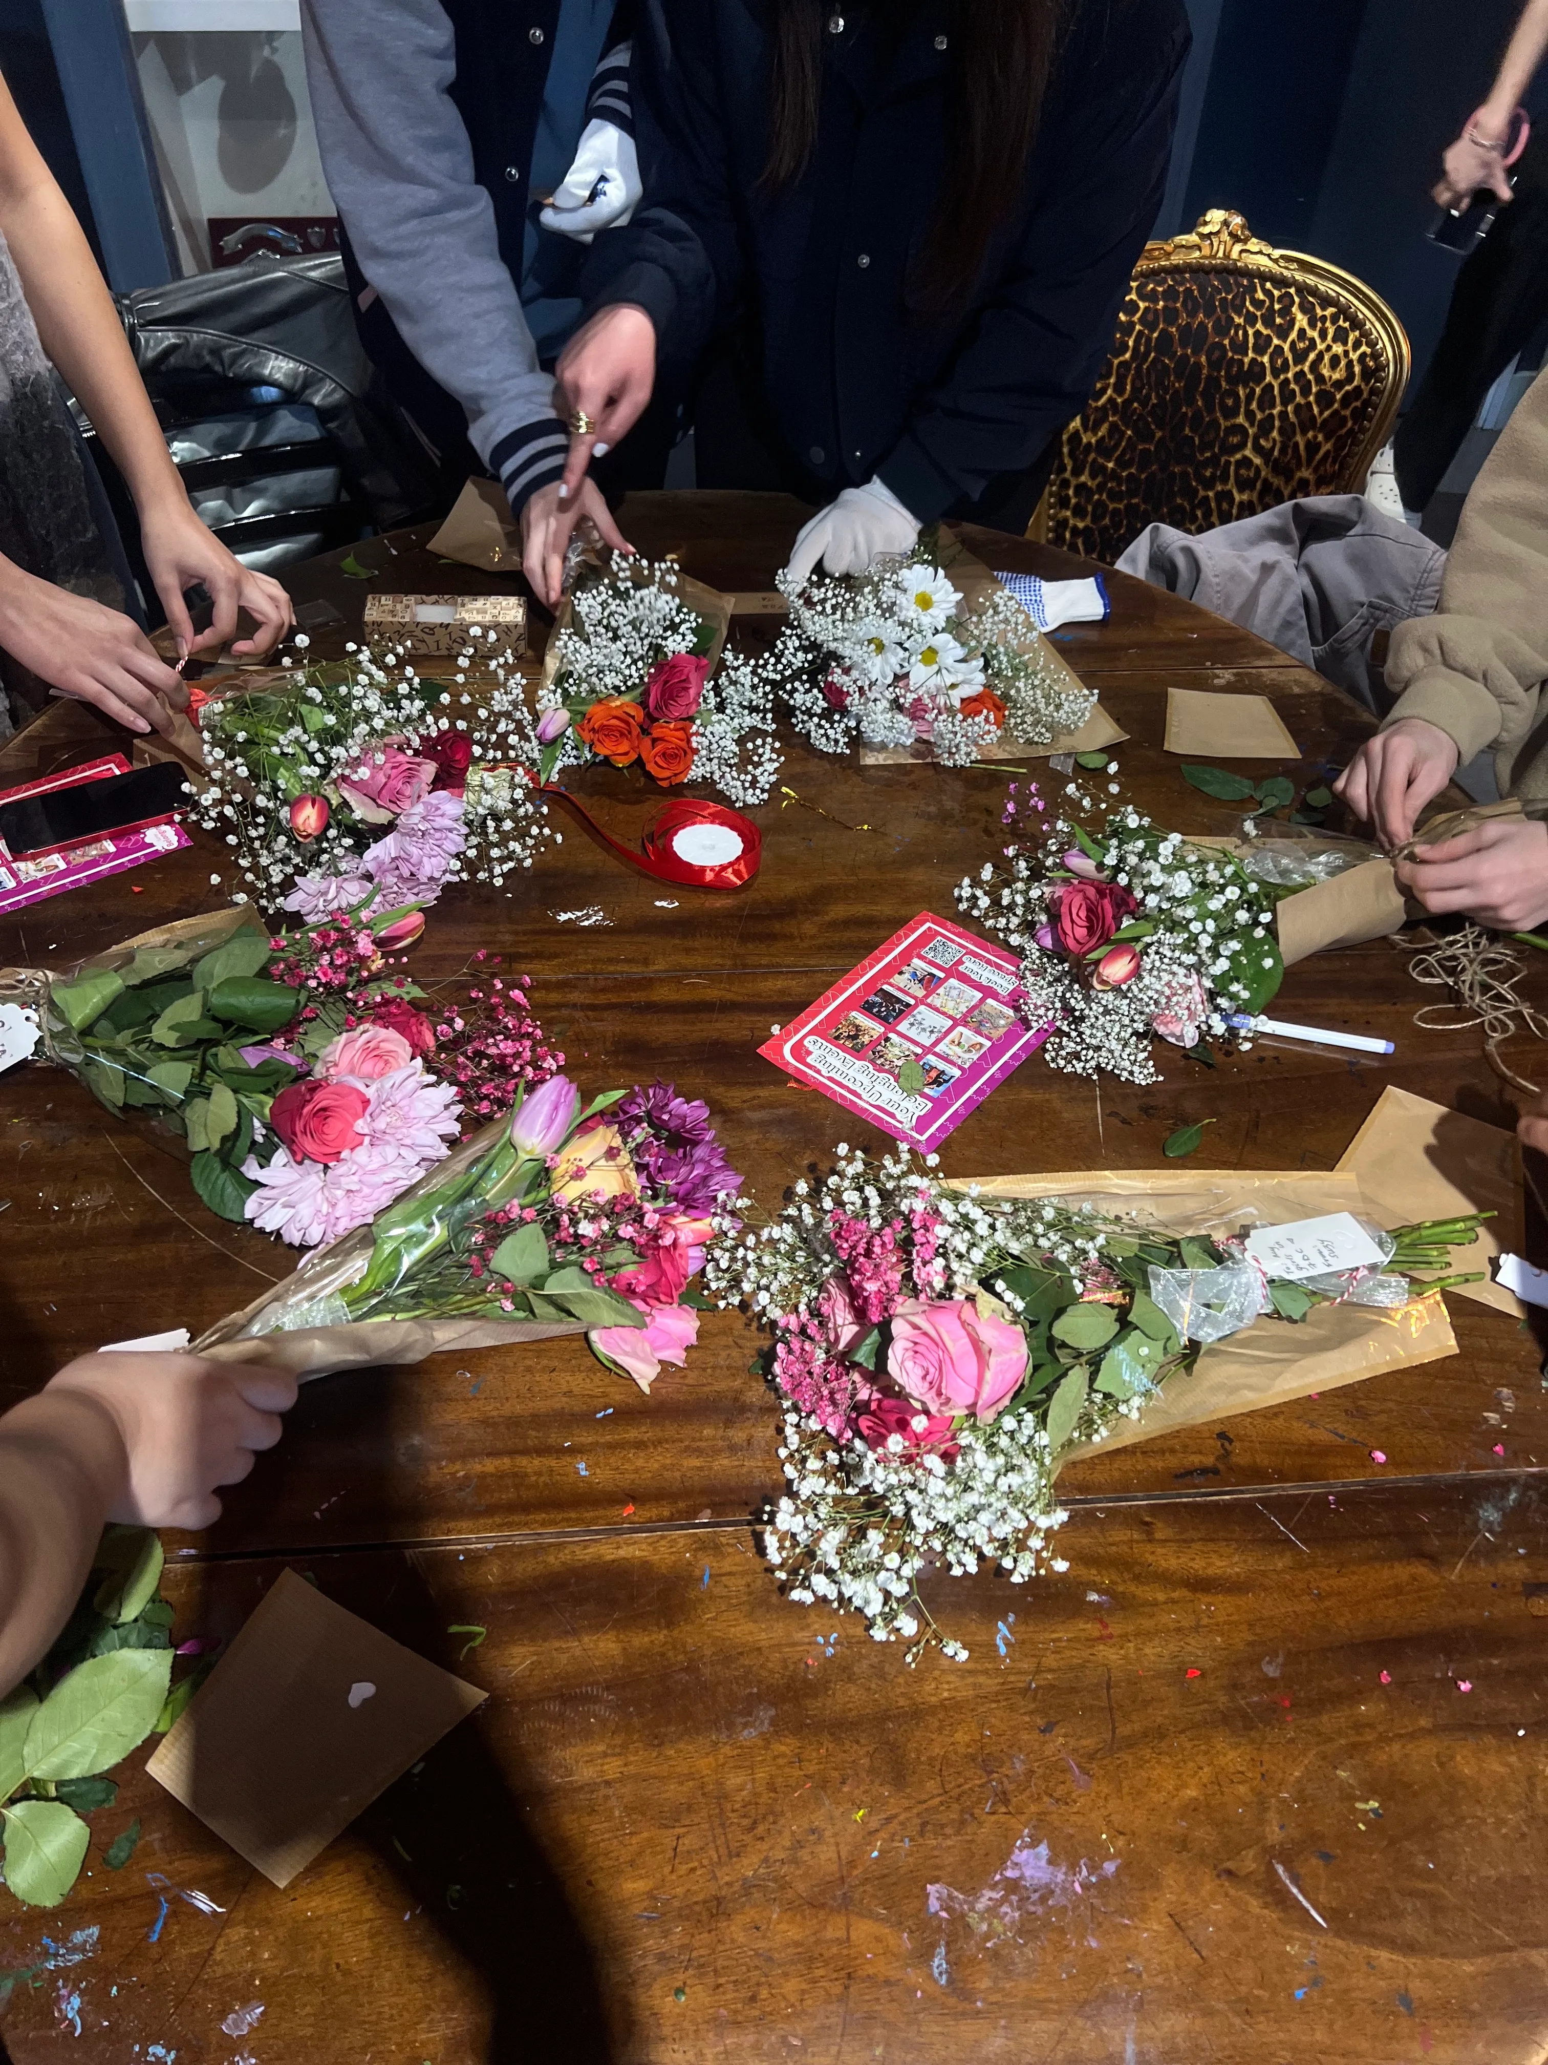
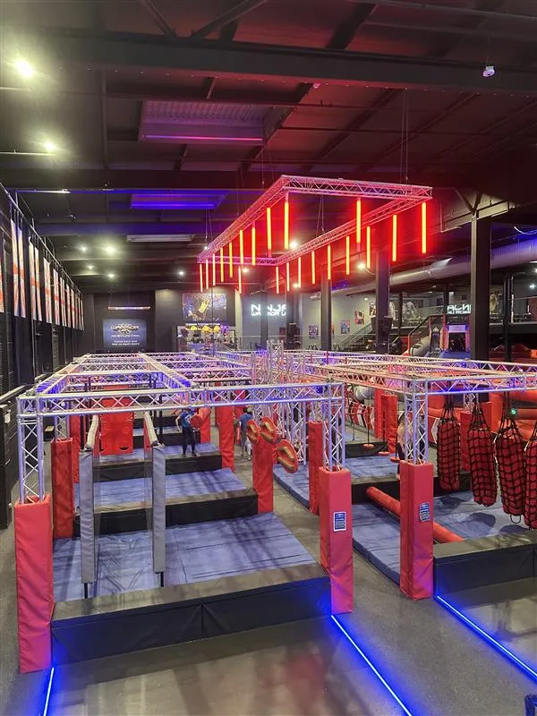

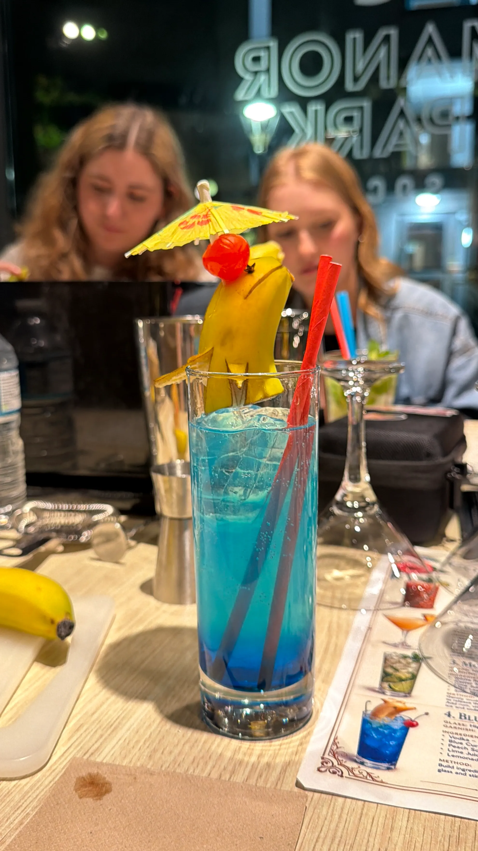
Surrey
Belonging
Surrey Belonging is about bringing together the student community at the University of Surrey through active, creative, and affordable events, which help students connect, engage, socialise, learn new skills, and gain unique experiences.
surreyunion.org
Your Surrey Life.

Slide 101
Social Socials
surreyunion.org
Your Surrey Life.
Notes:
Inclusivity
Doing the same thing gets the same people

Slide 102
Spotlight on…
surreyunion.org
Your Surrey Life.

Slide 103

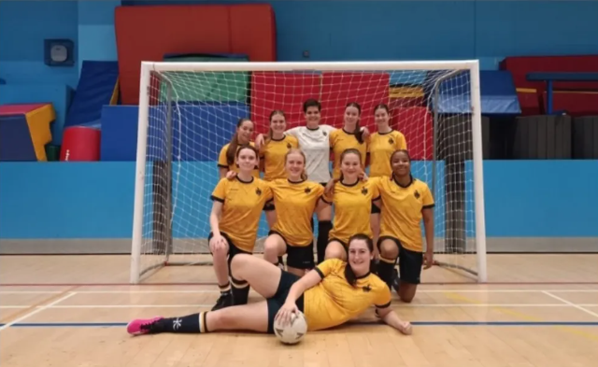
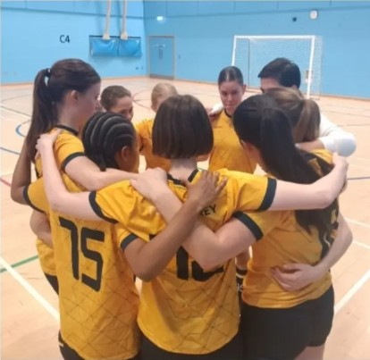
Futsal
Openness
Pragmatic
Fun
surreyunion.org
Your Surrey Life.

Slide 104
Be Intentional
BUILD
THE
GOAL
surreyunion.org
Your Surrey Life.

Slide 105
Why are YOU here?
Been a Wellbeing Champion before?
Love building community?
Love supporting your peers in serious moments?
Want to support your club / society?
Want to build your own skills?
ALL of these are great but BUILD THE GOAL in all aspects of the role.
surreyunion.org
Your Surrey Life.

Slide 106
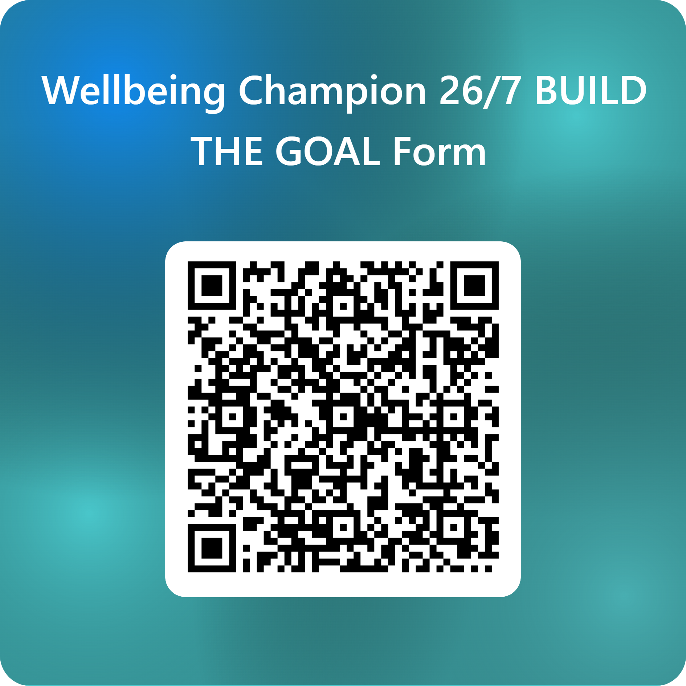
surreyunion.org
Your Surrey Life.

Slide 107

surreyunion.org
Your Surrey Life.

Slide 108
Average Student
Wellbeing Champion
Senior
Wellbeing Champion
surreyunion.org
Your Surrey Life.

Slide 109
Monthly Upskilling Sessions
Session 1: How to be active not passive
Active Listening & Active Bystander – TBC
surreyunion.org
Your Surrey Life.

Slide 110
The Roles of Wellbeing Champions
What are your roles?
Be a known face within your club / society.
Be available to members to come to talk to.
Be knowledgeable about support available.
Be proactive in supporting members and engaging them in you club / society.
Be in contact with the SU about issues & opportunities.
surreyunion.org
Your Surrey Life.

Slide 111
Support for you!
Take as much support as you give!
Signposting Guide
The Union Support team are here for you as well:
Craig.Aldridge@surrey.ac.uk
Ussu.advice@surrey.ac.uk
surreyunion.org
Your Surrey Life.

Slide 112
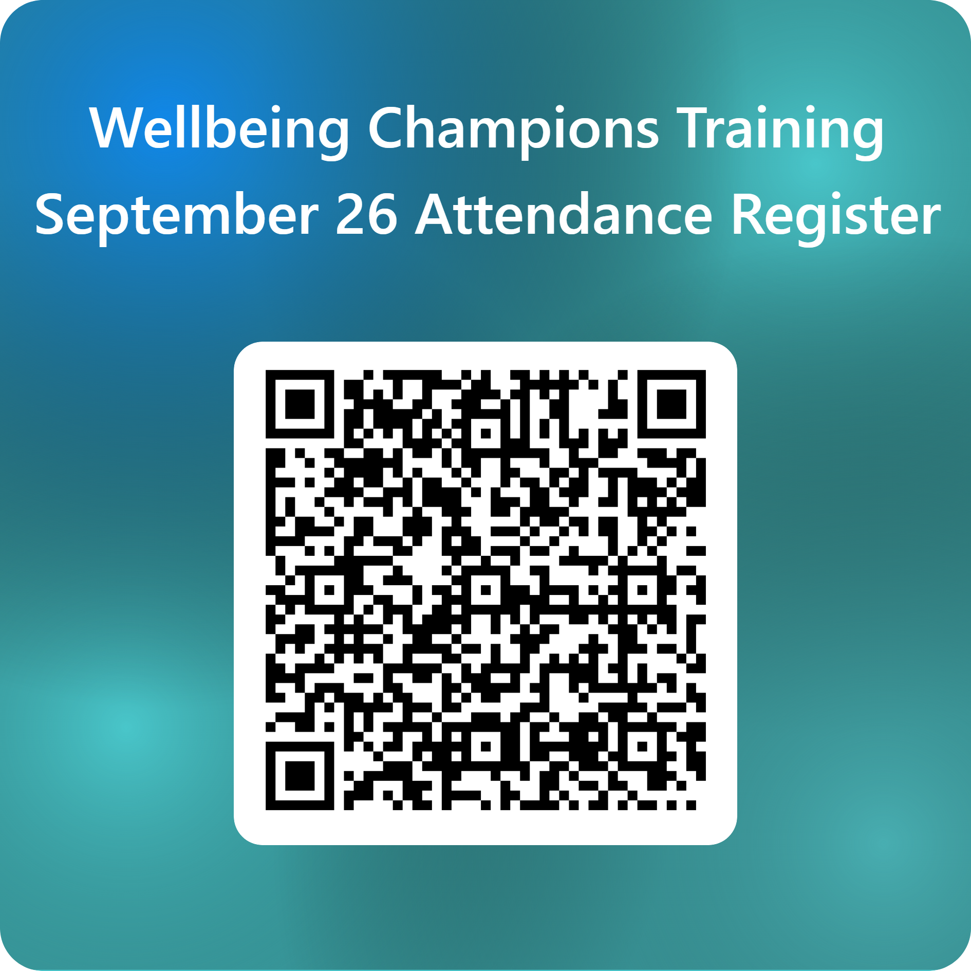
Thank you.
Attendance register
surreyunion.org
Your Surrey Life.

Slide 113
How to be active not passive
Active Listening & Active Bystander – Thursday 9th October 12:00 04 LTF
Online recordings:
Active Listening – Former Students Union President Liam White
Learn how to listen
How to let someone know you are empathising
How to hear what is really being said
How silence can be more helpful than words
Active Bystander – Support Zone Manager Charlotte Mills
Learn what it means to be an active bystander
What situations we may want to intervene in
Why we want to intervene and the impact not can have
Practical tips for how to intervene safely and productively
surreyunion.org
Your Surrey Life.

Slide 114
surreyunion.org
Your Surrey Life.

Slide 115
Examples:
A student of your society is messaging you every day on your personal social media…
surreyunion.org
Your Surrey Life.

Slide 116
Examples:
A student of your society is messaging you every day on your personal social media…
  Politely remind them to use the official communication channels via that method (Teams). Raise it with the rest of the committee and do not engage further on personal social media.
  Unfollowing / removing is ok.
surreyunion.org
Your Surrey Life.

Slide 117
Examples:
A student is very distressed over an academic issue and while you’re trying to signpost them, they insult you, swearing at you / becoming aggressive…
surreyunion.org
Your Surrey Life.

Slide 118
Examples:
A student is very distressed over an academic issue and while you’re trying to signpost them, they insult you swearing at you / becoming aggressive...
  Remain calm and do not engage in making the conversation worse
  You do not have to accept abuse.
  Give a warning and say you are prepared to talk about this when they are calmer.
  Send the signposting information and make other committee members aware.
  If required please Report & Support and / or contact the SU.
surreyunion.org
Your Surrey Life.

Slide 119
Examples:
A student is undergoing very traumatic events in their life and because they are nice you want to help them.
However you noticed that it is taking up a lot of your time…
surreyunion.org
Your Surrey Life.

Slide 120
Examples
A student is undergoing very traumatic events in their life and because they are nice you want to help them. However, you noticed that it is taking up a lot of your time…
  Remember your boundaries & communicate them again
  You're not a therapist even if they're nice, your wellbeing comes first - signpost to more appropriate support.
  Speak to the SU and we can be a place for you to share your concerns
surreyunion.org
Your Surrey Life.

Slide 121
Slide title here
Info box title
Info box text
Text
surreyunion.org
Your Surrey Life.

Slide 122
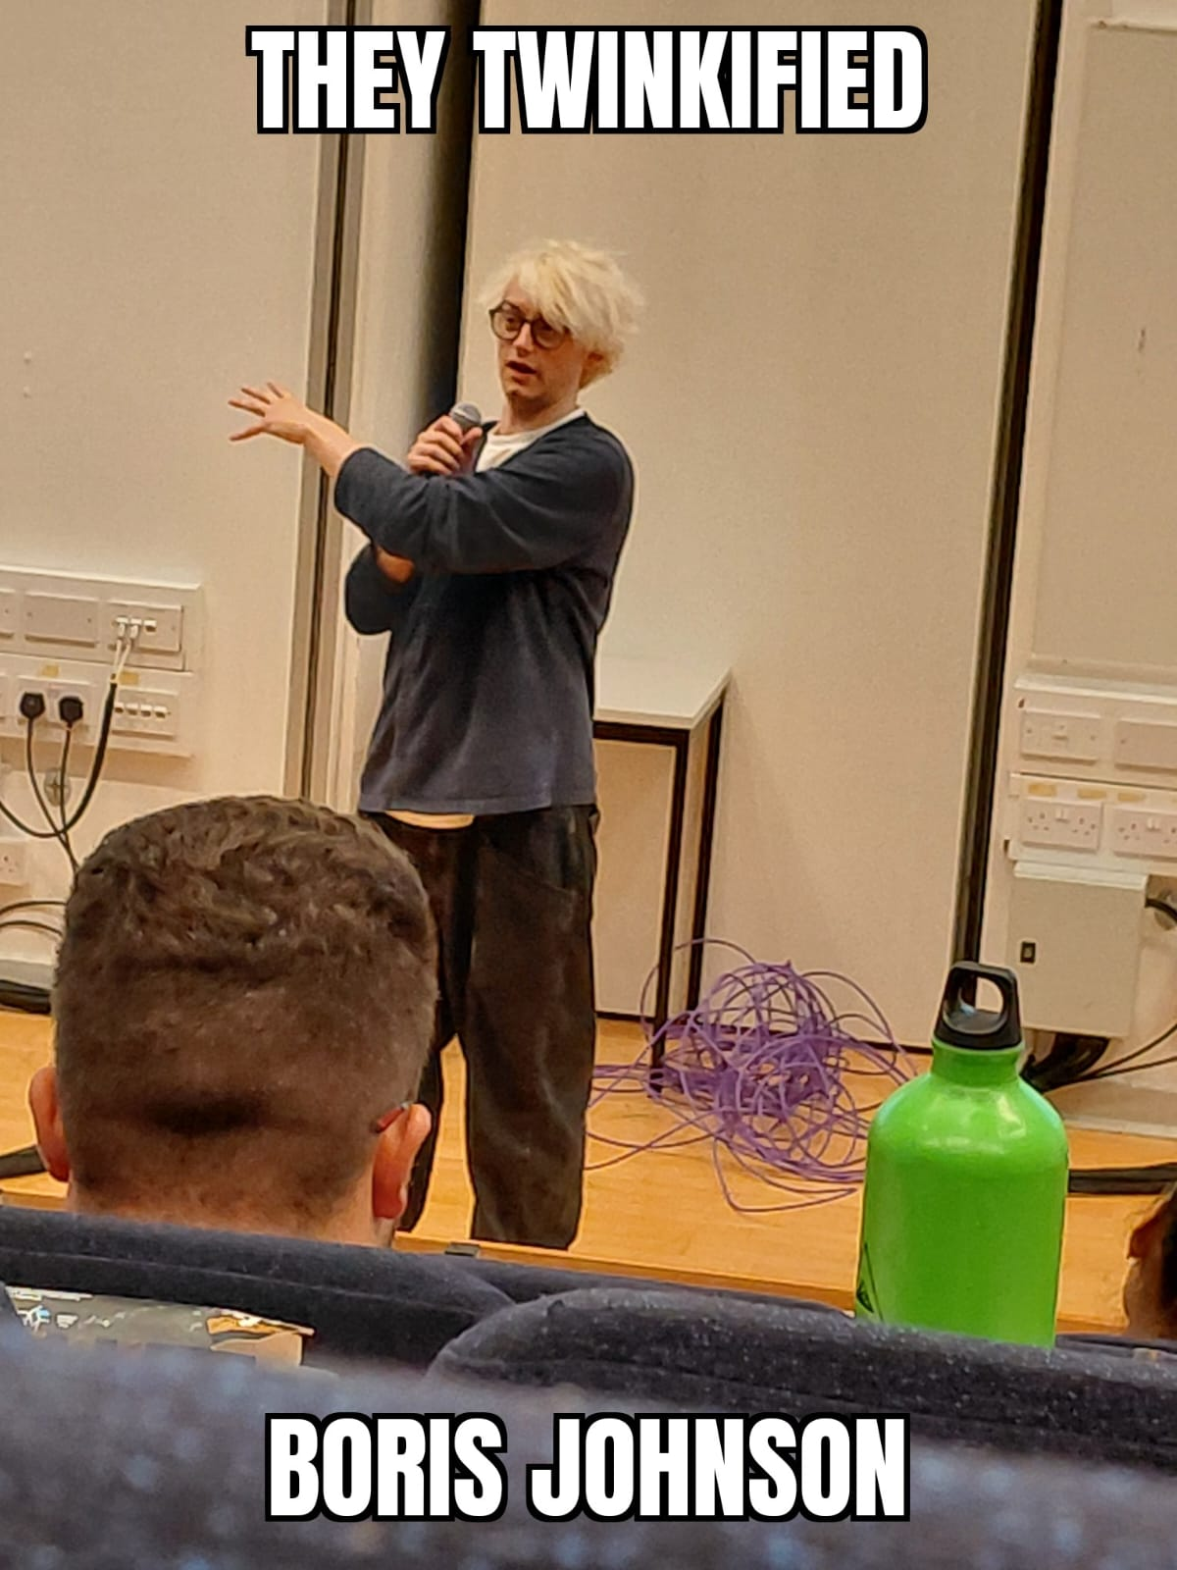
surreyunion.org
Your Surrey Life.

Slide 123
Slide title here
Info box title
Info box text
Text
surreyunion.org
Your Surrey Life.

Slide 124
I’m a section header
I could be a sub heading

Slide 125
I’m a section header
I could be a sub heading

Slide 126
I’m a section header
I could be a sub heading

